Slide 1
Score Rules

Slide 2
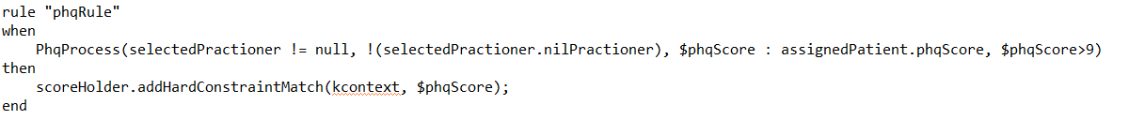
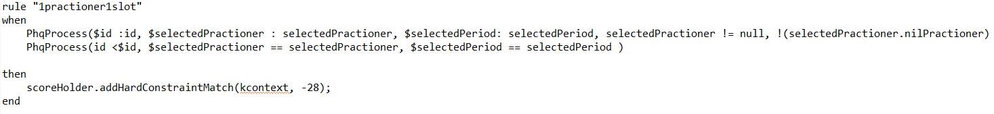
Hard Constraint and Hard Score Rules
PHQ score is the hard constraint. Hence, the rule will increase the hard score using PHQ-9 value.
On the other hand, 1 practitioner is only to engage 1 patient at 1 time slot.

Slide 3
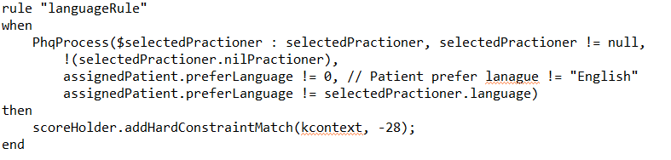
Hard Constraint and Hard Score Rules
Language is another hard constraint. When a patient has a requirement on communication language, it should be fulfil. Hence, whenever patient’s language is not matching practitioner’s language, the hard score will be deducted.

Slide 4
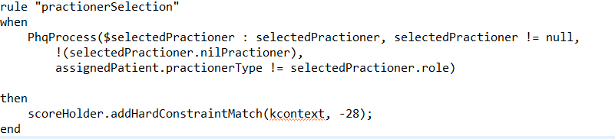
Hard Constraint and Hard Score Rules
Different patient requires different type of practitioner.
Hence, hard score will be deducted if the practitioner type is not matching patient’s requirement.

Slide 5
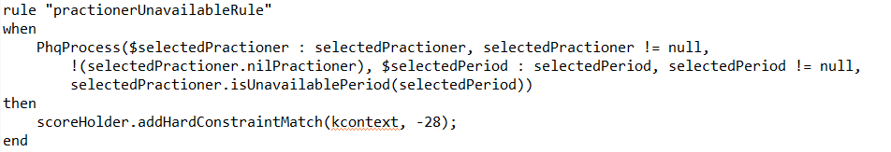
Hard Constraint and Hard Score Rules
The practitioner can also take leave on the certain day of the week.
Hard score will be deducted accordingly.

Slide 6
Soft Constraint and Soft Score Rules
Practitioners’ gender, session location and session weekday preferred by the patient’s convenience will increase the soft score.

Slide 7
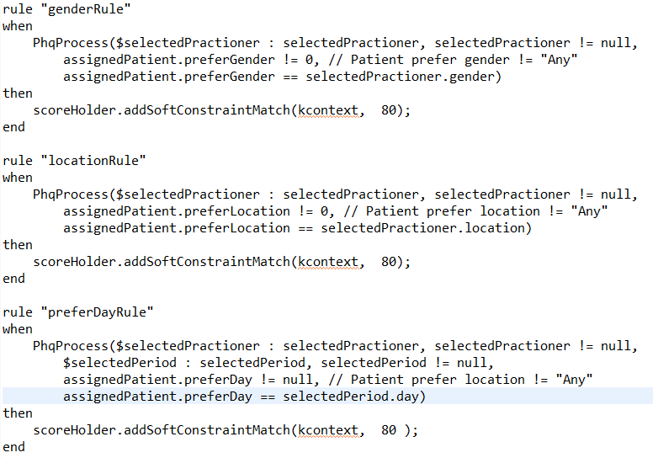

Slide 8
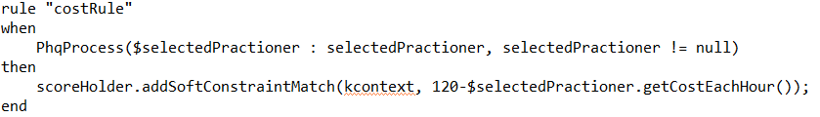
Soft Constraint and Soft Score Rules
Practitioners’ session cost will also be considered. The soft score is increased by the saving from maximum cost among the practitioners.

Slide 9
Comparison in between Searching Method

Slide 10
Simulation comparison
The local search type is chosen based on simulations.
A typical search space involves enough practitioner for patients.
All the search are based on first fit increasing method. Then the local search is performed.

Slide 11
Late Acceptance (LAHC)
LAHC is a hill climbing method but allow weaker solution to be chosen with criteria. Late acceptance means a solution S’ is accepted if its fitness is still larger than the fitness in L step earlier.
Optaplanner provide option to tweak the late acceptance L parameter. In Optaplanner, L step size is defined as late acceptance size. (note that the KIE optaplanner workbench may not allow the tweaking)

Slide 12
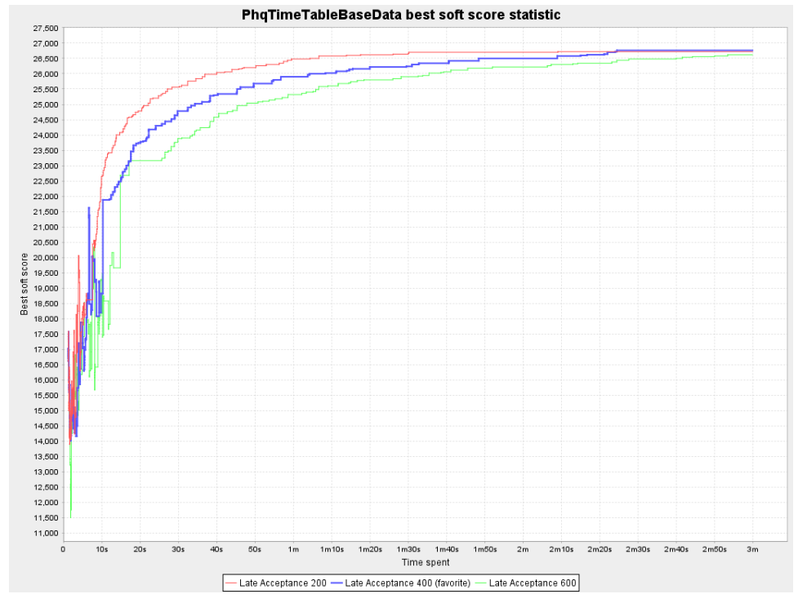
L=400 is a better choice compared to L=200 and L=600.
Increasing L slow the convergence but decreasing it drastically may results in local extrema.

Slide 13
Late Acceptance (LAHC)
Late acceptance size 400 is optimal for optaplanner where it is able to reach maximum score with less time.
Increase acceptance size slow down the convergence speed.
Decrease acceptance size increase the convergence speed but may not be returning the optimal result.
Hence, L=400 is a better choice compared to L=200 and L=600.

Slide 14
Tabu Search
Tabu means “sacred and untouchable” in a native tribe language.
Tabu search means a local search which do not choose the explored search domain.
Tabu entity size, T specify the search value within T step is not to be repeated.
Thus, tabu search can be used after first fit construction.
Optaplanner allows T to be altered (as Tabu entity size).

Slide 15
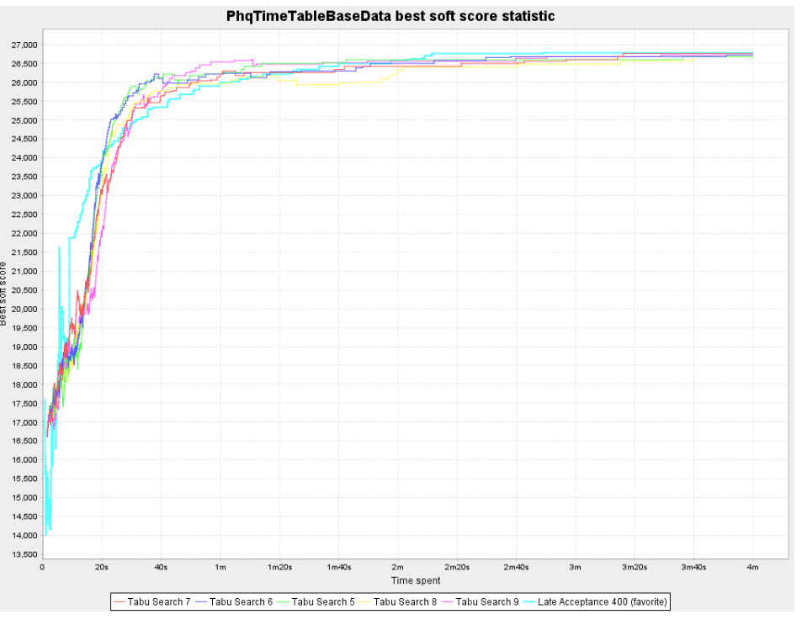
Tabu size of 7 is the most optimal for Tabu Search.
However, it is still slower than LAHC with L=400 in getting global extrema.

Slide 16
Tabu Search
T is found to be optimized as 7 (as compared with T=6,5,8,9) in the problem domain. Increasing T may unnecessarily restrict the value to be repeated while decreasing T may ended with extra searching while not finding the way to get out of local extrema.
Compare with local acceptance with 400 as acceptance size, Tabu search with Tabu size of 7 may be effective in earlier stage but it may not getting into global maxima faster than LAHC.
Hence, LAHC with late acceptance size of 400 is still preferable.

Slide 17
Simulated Annealing
Simulated annealing is derived from the annealing process in forging process. Temperature function decides where the next search to go.
Optaplanner allows simulated annealing to be performed after a certain value of hard/soft score.
In our problem domain, simulated annealing is converging slower than the LAHC with L=400.

Slide 18
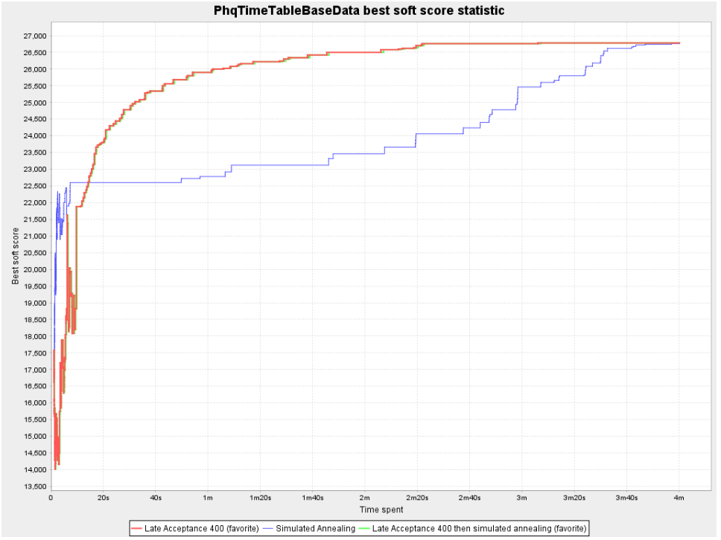
In our problem domain, simulated annealing is converging slower than the LAHC with L=400.

Slide 19
Harder Scenario
In scenario where Tamil speaking practitioners are not available, the search may requires a longer time.
Few type of local search are compared again.
However, LAHC is again giving the maximum count with less time despite the tabu search is still giving a higher score at the beginning.

Slide 20
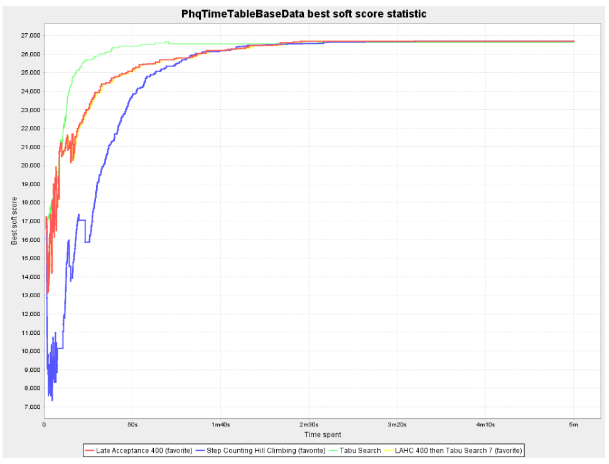
LAHC is again giving the maximum count with less time despite the tabu search is still giving a higher score at the beginning

